Slide 1

Clustering
GitHub

Slide 2
Agenda
What is clustering?
Where is clustering used?
Types of Clustering
What is K-means clustering?
How does a K-Means Algorithm work?
K-Means with Python

Slide 3
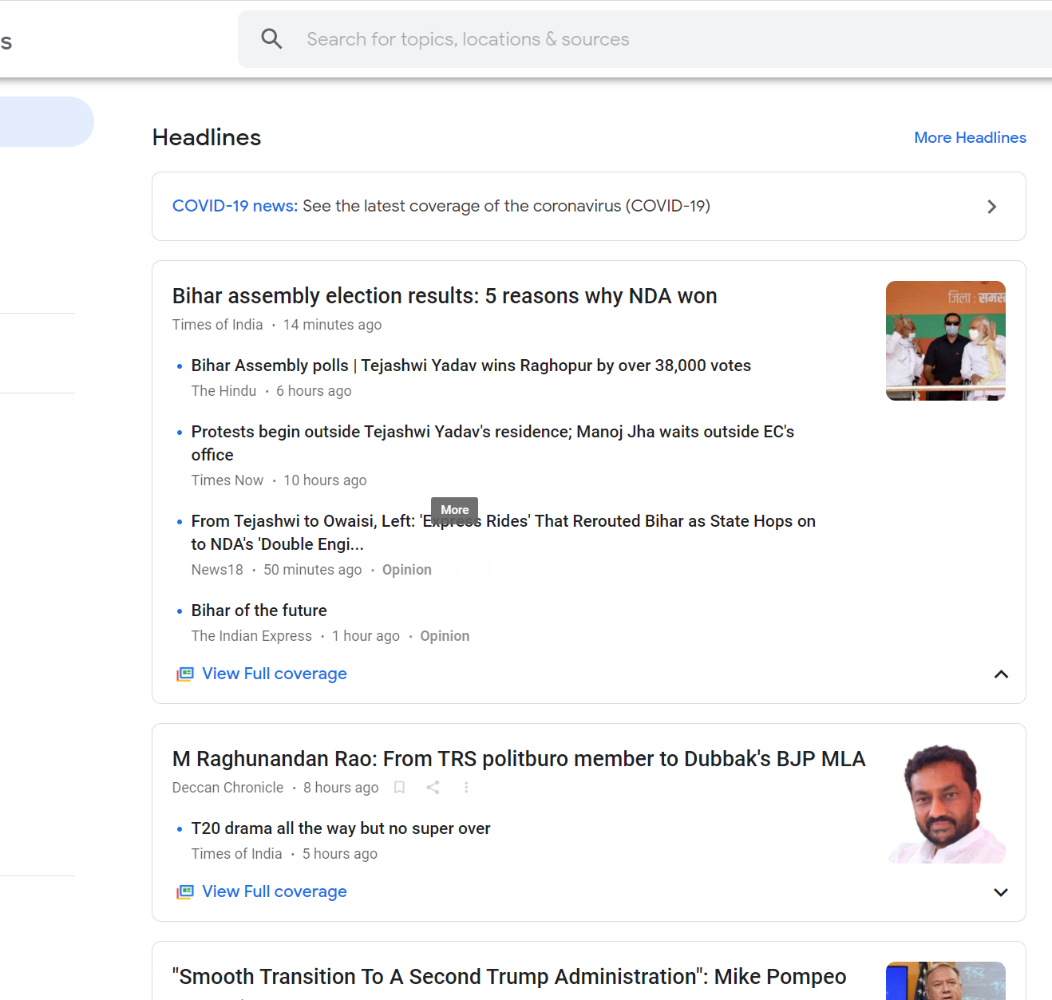
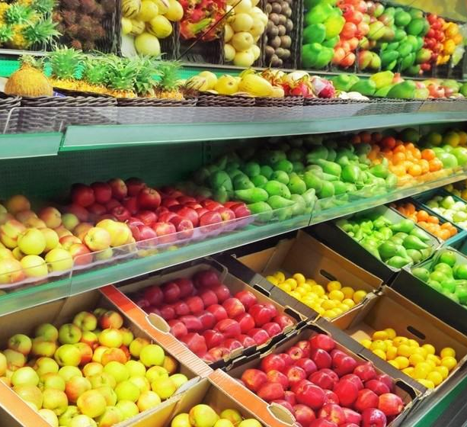
What is Clustering?
News stories grouped together
Clustering is the process of dividing the datasets into groups. Consisting of similar data-points
Points in the same group are similar as possible
Points in different group are as dissimilar as possible
Items arranged in a supermarket

Slide 4

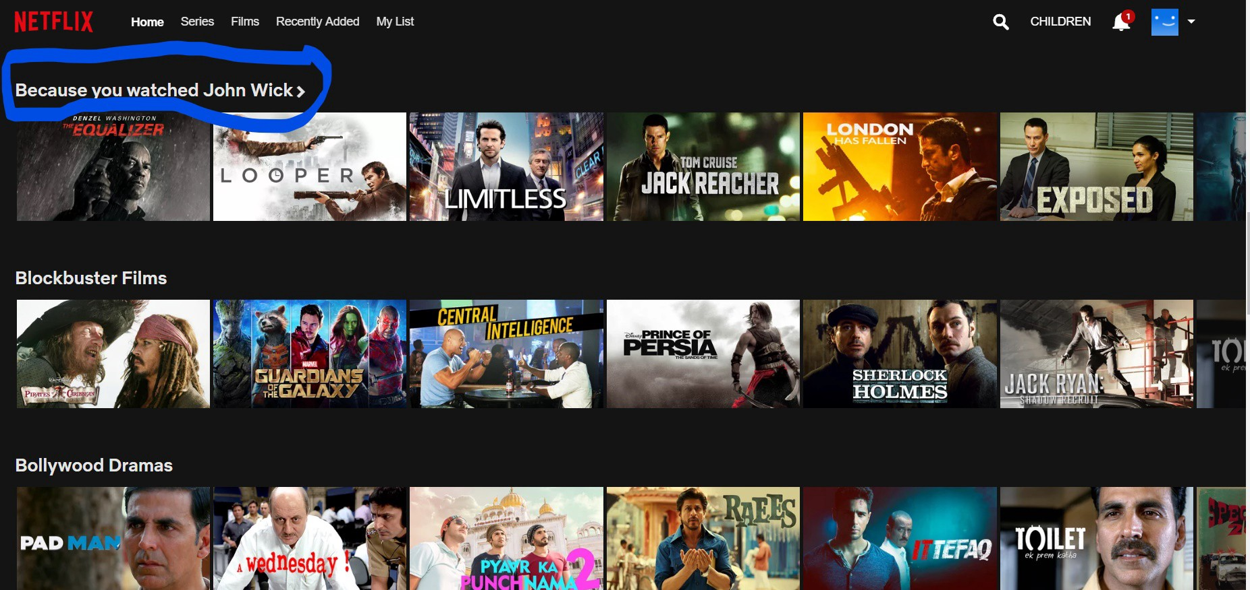
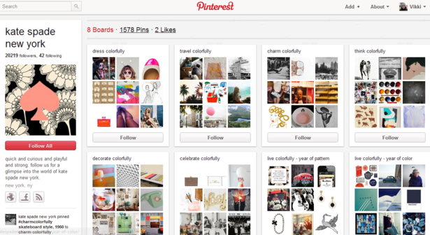
Where is Clustering Used?
When you see a high percentage of specific terms in an article, algorithm gives a higher probability of the material being fake news.
Netflix clusters similar movies to generate recommended movies
Pinterest identifies content that resembles previous users pins and recommends that content to the user

Slide 5
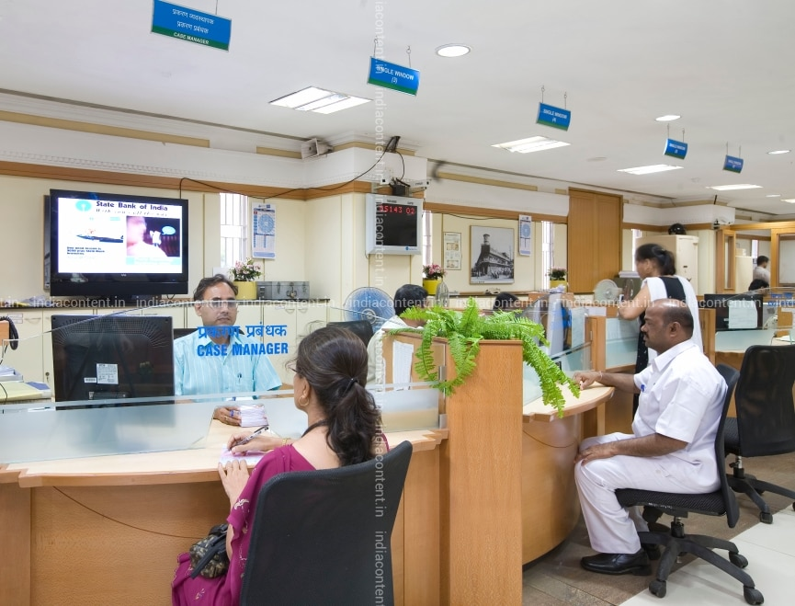

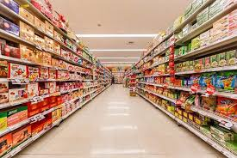
Other applications of Clustering
Banking
Insurance Companies
Retail

Slide 6
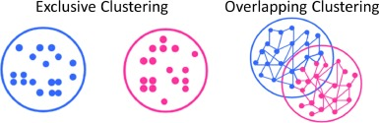
Types of Clustering
Exclusive Clustering
Hard Clustering
Data Point / Item belongs exclusively to one cluster
Example K-Means clustering

Slide 7
Types of Clustering
Overlapping Clustering
Soft Clustering
Data Point / Item belongs multiple cluster
Example Fuzzy/ C-Means Clustering/Weighted KMeans

Slide 8
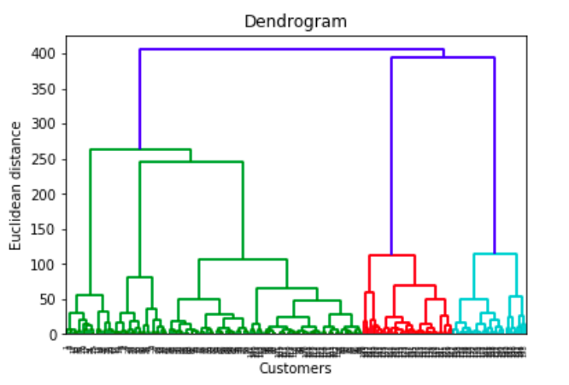
Types of Clustering
Hierarchical Clustering
A method of cluster analysis which seeks to build a hierarchy of clusters.
Example Dendrogram

Slide 9

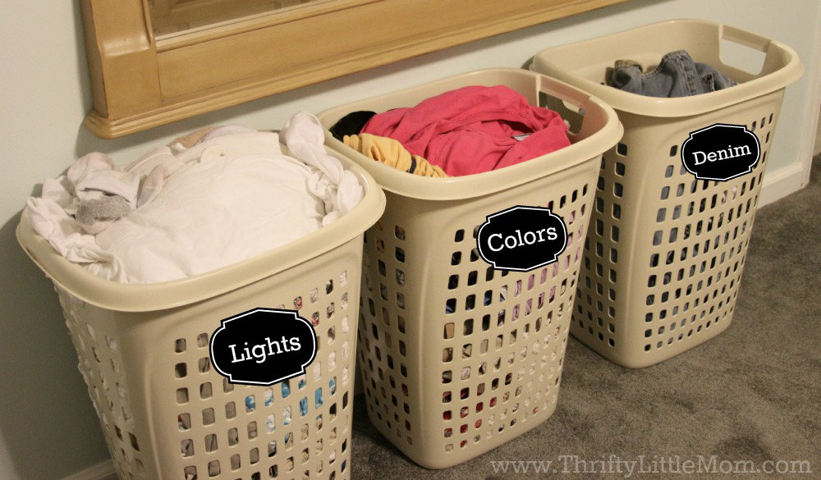
What is K-Means Clustering?
K-Means is a clustering algorithm whose main goal is to group similar elements or data points into a cluster
Note: ‘K’ in K-means represent the number of clusters
Pie of Laundry
Laundry by Color

Slide 10
Where can I apply K-Means clustering?
Document Classifier

Slide 11
K-Means Algorithm

Slide 12
K-Means Algorithm

Slide 13
K-Means Algorithm
1. Select the number of clusters K = 3

Slide 14
K-Means Algorithm
Select the number of clusters K = 3
Select 3 random data points

Slide 15
K-Means Algorithm
Select the number of clusters K = 3
Select 3 random data points
Measure the distance between 1st point and 3 selected data points
Distance between 1st data point and green cluster

Slide 16
K-Means Algorithm
Select the number of clusters K = 3
Select 3 random data points
Measure the distance between 1st point and 3 selected data points
Distance between 1st data point and red cluster

Slide 17
K-Means Algorithm
Select the number of clusters K = 3
Select 3 random data points
Measure the distance between 1st point and 3 selected data points
Distance between 1st data point and blue cluster

Slide 18
K-Means Algorithm
Select the number of clusters K = 3
Select 3 random data points
Measure the distance between 1st point and 3 selected data points
Assign the 1st point to nearest cluster (green)

Slide 19
K-Means Algorithm
Select the number of clusters K = 3
Select 3 random data points
Measure the distance between 1st point and 3 selected data points
Assign the 1st point to nearest cluster (green)
Calculate the mean value including the new point for
green cluster

Slide 20
K-Means Algorithm
Which cluster does point 2 belong
Distance between 2nd data point and red cluster

Slide 21
K-Means Algorithm
Which cluster does point 2 belong
Distance between 2nd data point and blue cluster

Slide 22
K-Means Algorithm
Which cluster does point 2 belong
Add the point to the nearest cluster

Slide 23
K-Means Algorithm
Which cluster does point 4 belong
Measure the distance
Assign the point to the nearest cluster

Slide 24
K-Means Algorithm
Which cluster does point 4 belong
Measure the distance
Assign the point to the nearest cluster
Calculate the mean of the cluster

Slide 25
K-Means Algorithm
Which cluster does point 6 belong
Measure the distance
Assign the point to the nearest cluster
Calculate the mean of the cluster

Slide 26
K-Means Algorithm
Which cluster does point 6 belong
Measure the distance
Assign the point to the nearest cluster
Calculate the mean of the cluster

Slide 27
K-Means Algorithm
Repeat the steps

Slide 28
K-Means Algorithm
Repeat the steps
Expected Results
First Iteration Result

Slide 29
K-Means Algorithm
Repeat the steps
Notes:
We can tell the quality of the cluster by finding the variance within each cluster

Slide 30
K-Means Algorithm
Repeat the steps
Total variation within the cluster
K-means Algorithm it iterates over again and again unless and until the data points within each cluster stops changing
Notes:
K-means can’t tell which is the best clustering. But it keeps a track of these clusters and corresponding variance

Slide 31
K-Means Algorithm
Iteration 2: Again we will start from the beginning. But this time we will be selecting different initial random point (as compared to what we chose in the 1st iteration

Slide 32
K-Means Algorithm
Iteration 2: Again we will start from the beginning. But this time we will be selecting different initial random point (as compared to what we chose in the 1st iteration
Select the number of clusters K = 3
Select 3 random data points
Measure the distance between 1st point and 3 selected data points

Slide 33
K-Means Algorithm

Slide 34
K-Means Algorithm

Slide 35
K-Means Algorithm

Slide 36
K-Means Algorithm

Slide 37
K-Means Algorithm

Slide 38
K-Means Algorithm

Slide 39
K-Means Algorithm

Slide 40
K-Means Algorithm
Total variation within the cluster

Slide 41
K-Means Algorithm
Iteration 3: Again we will start from the beginning. But this time we will be selecting different initial random point (as compared to what we chose in the 1st iteration

Slide 42
K-Means Algorithm
Iteration 3: Again we will start from the beginning. But this time we will be selecting different initial random point (as compared to what we chose in the 1st iteration
Select the number of clusters K = 3
Select 3 random data points
Measure the distance between 1st point and 3 selected data points

Slide 43
K-Means Algorithm

Slide 44
K-Means Algorithm

Slide 45
K-Means Algorithm

Slide 46
K-Means Algorithm

Slide 47
K-Means Algorithm

Slide 48
K-Means Algorithm

Slide 49
K-Means Algorithm

Slide 50
K-Means Algorithm

Slide 51
K-Means Algorithm

Slide 52
K-Means Algorithm
Total variation within the cluster

Slide 53
K-Means Algorithm
Total variation within the cluster
The algorithm can now compare the result and select the best variance out of it
Iteration 1
Iteration 2
Iteration 3

Slide 54
K-Means Algorithm
1. Select k
2. If k=2 select 2 random points as centroid
3. Find Euclidian distance between 2 points and assign them to nearest clusters
4. Find the mean of the cluster with the new point in it
5. Iterate until you get the lowest sum of variation within cluster

Slide 55
How will you find a K value
Total variation within the cluster
K = 1

Slide 56
How will you find a K value
Total variation within the cluster
K = 1
K = 2

Slide 57
How will you find a K value
Total variation within the cluster
K = 1
K = 2
K =3
Each Time you increase the cluster the variation decreases
When the # of clusters = # of data points then in that case the variation = 0

Slide 58
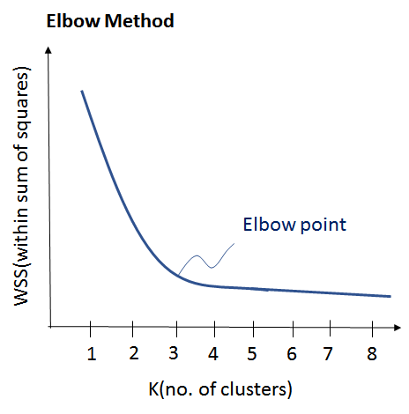
How will you find a K value
This Elbow point is used to determine the value of K(Clusters)

Slide 59
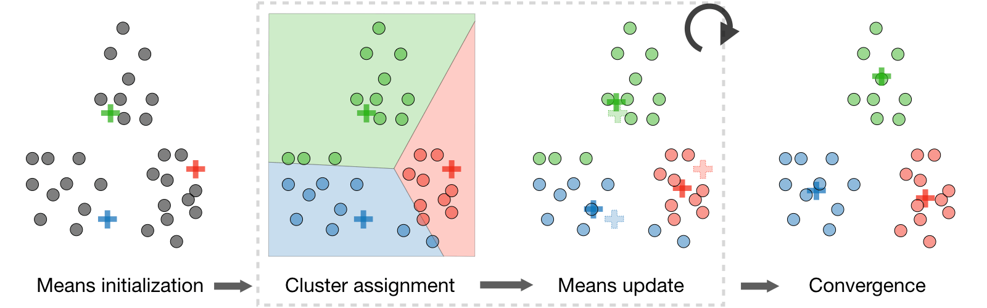
K –Means Algorithm
Summarizing the K-Means Algorithm
Randomly chose k examples as initial centroids
White true:
create k clusters by assigning each example to closest centroid
compute k new centroids by averaging examples in each cluster
if centroids don’t change
break

Slide 60
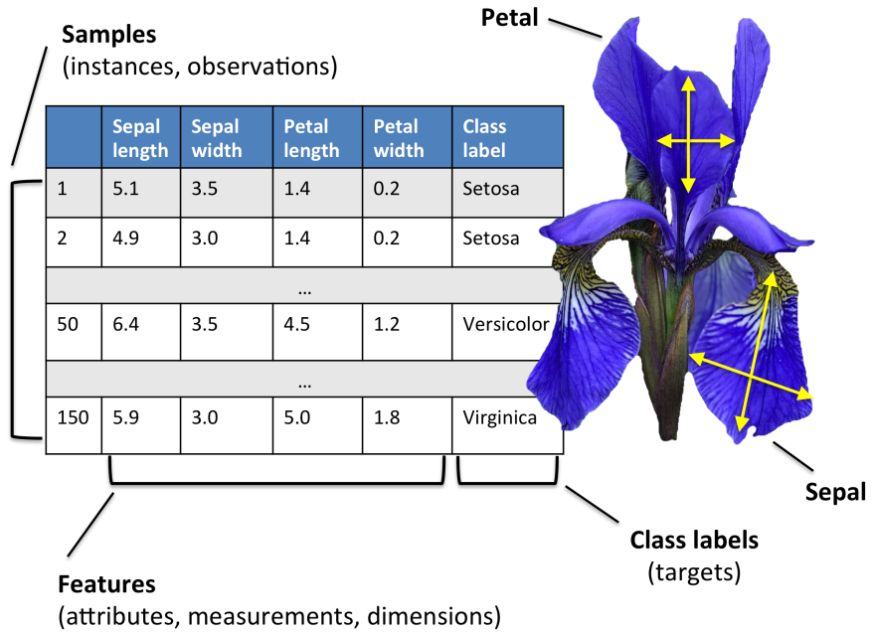
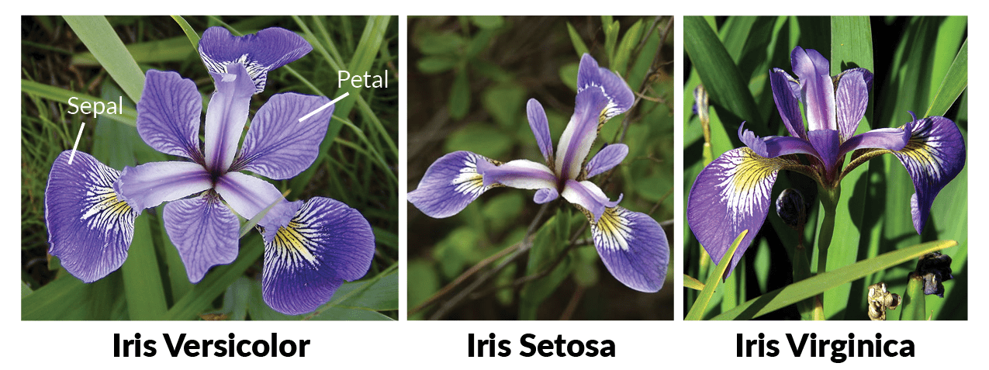
Iris Dataset

Slide 61
Clustering Python Demo
GitHub

